Slide 1

DriverPass System Analysis
Bee Best
Notes:
Woo no speaker notes here :3

Slide 2

System Requirements
Functional Requirements:
The system shall validate user credentials
The system shall allow users to manage lessons
Non-Functional Requirements:
Ability to run on any platform.
Updates via DMV
Notes:
Taking a look at just a couple functional and non-functional requirements, we can get a better idea of what the system is meant to do.
Starting off with the functional requirements I chose as examples, we have the first one which is essentially stating that the system must be able to securely validate the user’s login information against a database when the user attempts to login, the second one regards the management of lessons, according to our requirements this must be able to be done by either accessing the online platform or by calling a secretary and giving them the relevant information.
Moving on to the non-functional requirements, the ability to run on any platform means just that, on PC it should be able to run regardless of OS and should at least run on the most popular browsers. When it comes to the automatic updates from the DMV, essentially this means that whenever the DMV updates their practice materials and sample questions, a notification should be sent such that we can update the system.

Slide 3
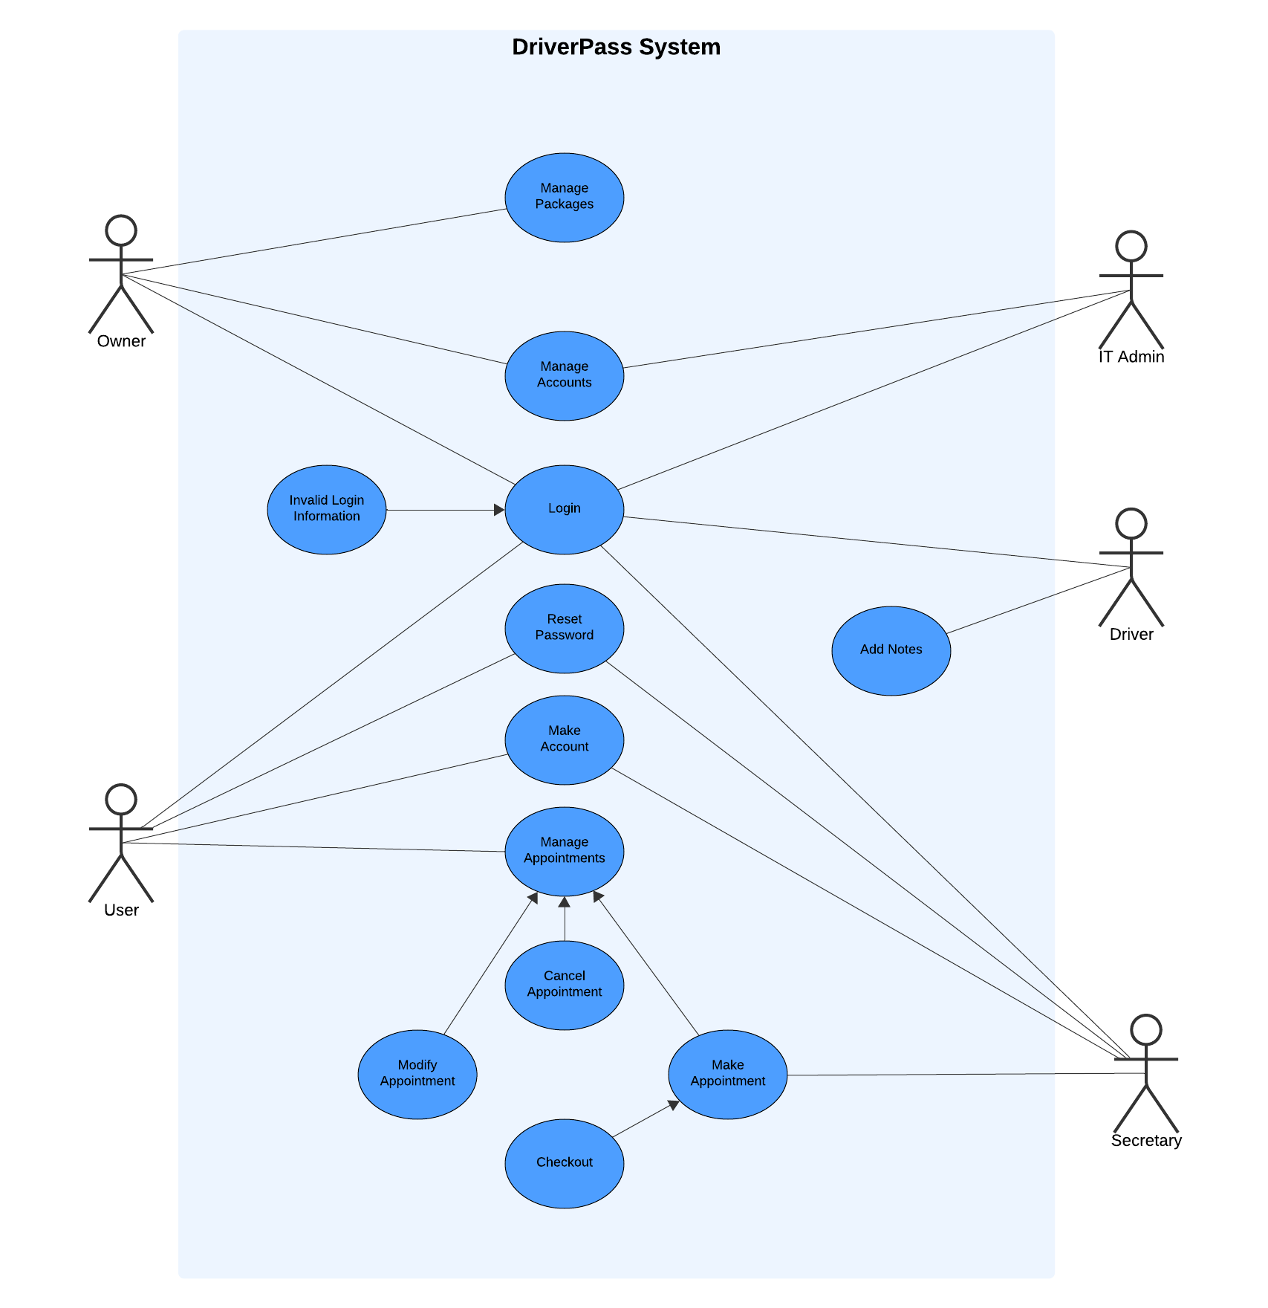
Use Case Diagram
Notes:
Now, the actual use case and the text involved might be a bit hard to see because of how small it is but I’ll just go through it and point to the relevant pieces as I go along so starting off at the bottom left we have the user, the diagram states that the user can login, reset their password, make an account, or manage appointments. We can see that the ability to manage appointments gives a few related things in the process, those being making one, cancelling one, or modifying one, and the related one at the bottom connecting to making an appointment is checking out, or rather, finalizing a purchase. Moving up we can see the owner, the owner is the only one who can manage the packages of the system, like everyone else they can login, and they can manage accounts. By the way this bit connected to login is in case someone enters an invalid login. Moving over, we see the IT Admin, essentially they act similar to the owner but with less privilege, they get to login and manage accounts and that’s really it. Moving down we have the driver, like everyone they can login, but they can also add notes to a student’s page which the student may view. Finally at the bottom right we have the secretary, they have a similar access as the normal users in that they can login, make accounts, reset passwords, and lastly they can make appointments. And that covers this diagram, as you can see it essentially is just saying what each type of person using the system can do.

Slide 4
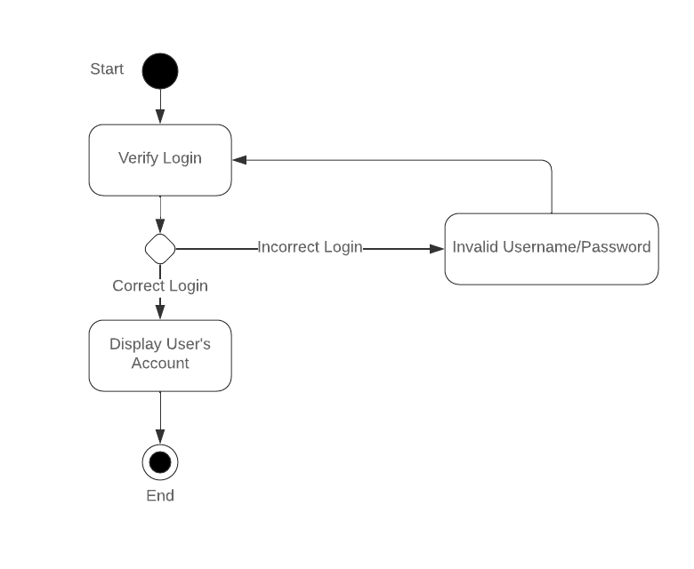
Activity Diagram
Notes:
Looking at this diagram now, it gives us a more detailed view of one of the prior actions that can be done by someone using the system, this one specifically is the case for logging in. We start with the user entering their account info, that being the username and login, and the first action the system takes is verifying that login, moving down we have a test, that being the verification, if it’s correct we move down, if not we move to the side where there’s a place for the system to do something to signify that the login info was wrong and we go back to the login verification step. Now going back to where we were, when the correct login in sued then it will display the user’s account and that’s where this specific action ends.

Slide 5
Security
The user may reset their password if lost or stolen
All communications must be encrypted to prevent leaks of account information
An account that is attempted to brute force login to should be locked
Notes:
We considered security very seriously for the system’s design due to the sensitive nature of all of the user information present. Of course, if an account is attempted to be broken into by force it would be locked to prevent this, furthermore a phone call should be made to the account owner to ensure they are aware of this and have the opportunity to change their account info. Next we have to obviously make sure our communications between the user, the system, and the database are secure so that no information can be obtained just by paying attention to the information being transmitted. Lastly if the owner of the account loses their password then they can reset it manually or via a phone call, in addition to this they should be able to change other important account information in certain circumstances such as if their email is compromised and they no longer have access to it then they should be able to change that via a phone call.

Slide 6
System Limitations
Staying within budget
Must be designed to run via cloud
Deadline for development (May 12)
Notes:
Looking at the limitations for our system design, these aren’t necessarily the limitations of what the system can do, rather they’re the limitations of the process of development, that being things like time, budget, and technology. Going through these we have the main two, budget and time, for the budget we have to factor in the development costs and also the costs of having to run the system via the cloud so we’ll be dealing with constant expenses for the system to be running, not only that but because we have to design it to run on this type of system we’ll be stuck with doing that, it’s something we can’t budge on based on the requirements we were given. Finally, we have the most obvious limitation, the deadline, we can only develop so much in an amount of time so we’ll have to create the entire system within the deadline which should be doable based on current schedules and planning although any project is subject to the possibility of delays although we do not expect it to cause us any substantial issues.

